Slide 1

ML5G-PS-007:Non-linear Power Amplifier Behavioral Modeling to achieve higher energy efficiency in 5G RAN
Memory Polynomial-Inspired Neural Network for
Modeling the Power Amplifier Non-linearities
Team MLAP
- Pedamalli Saikrishna
- Ashok Kumar Reddy Chavva
- Boddapati Hari Krishna
Beyond 5G Team
Samsung R&D Institute Bangalore

Slide 2
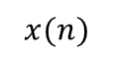
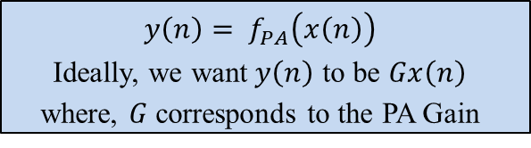
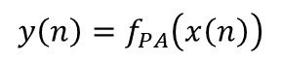
Introduction – Power Amplifier in Wireless Communication
Power Amplifier Requirement
Power Amplifier boosts the base band signal before transmitting.
Helps the signal reach receiver overcoming the path loss.
Challenges
Exhibits non-linear behaviour when operated at higher power.
This non-linearity affects signal quality and also causes inter channel interference.
$$x(n)$$
$$y\left(n\right)=f_{PA}\left(x\left(n\right)\right)$$
$$y\left(n\right)= f_{PA}\left(x\left(n\right)\right)$$
Ideally, we want$y\left(n\right)$ to be $Gx\left(n\right)$
where, $G$corresponds to the PA Gain
PA
Wireless Channel
Tx Antenna
Rx Antenna
Transmitter
Receiver
Signal to be transmitted
Modulator
PA
Demodulator
Received Signal

Slide 3
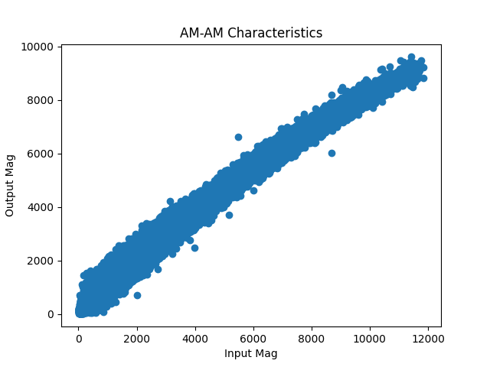
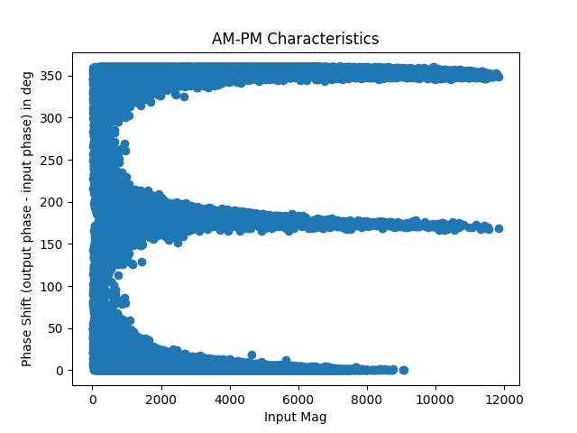
Introduction – Power Amplifier Non-linearities
Power Amplifier Non-linearity
AM – AM Characteristics.
Output amplitude varies non-linearly with input amplitude.
AM – PM Characteristics.
Phase shift in signal.
Memory.
Past samples having an effect on current sample output.

Slide 4
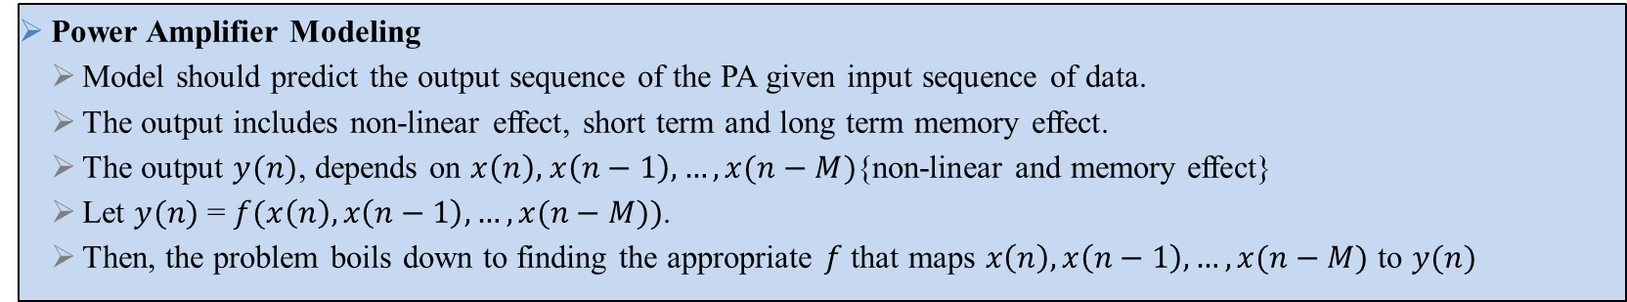
Problem Statement – Modeling Power Amplifier Non-linearities
Power Amplifier Modeling
Model should predict the output sequence of the PA given input sequence of data.
The output includes non-linear effect, short term and long term memory effect.
The output $y(n)$, depends on $x\left(n\right),$ $x\left(n−1\right), …, x(n−M)${non-linear and memory effect}
Let $y(n)$ = $f(x\left(n\right), x\left(n−1\right), …, x(n−M))$.
Then, the problem boils down to finding the appropriate $f$ that maps $x\left(n\right), x\left(n−1\right), …, x(n−M)$ to $y(n)$
Significance of Power Amplifier Modeling
Helps in understanding the distortions caused to the signal due to non-linearity introduced by the PA
Helps in designing algorithms to compensate for the distortions caused by the non-linearity.
Improves the quality of received signal.
Improves the efficiency of the wireless communication systems.

Slide 5
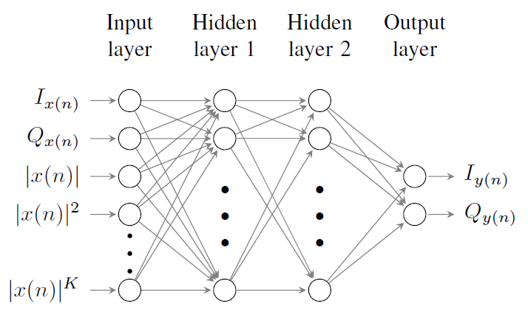
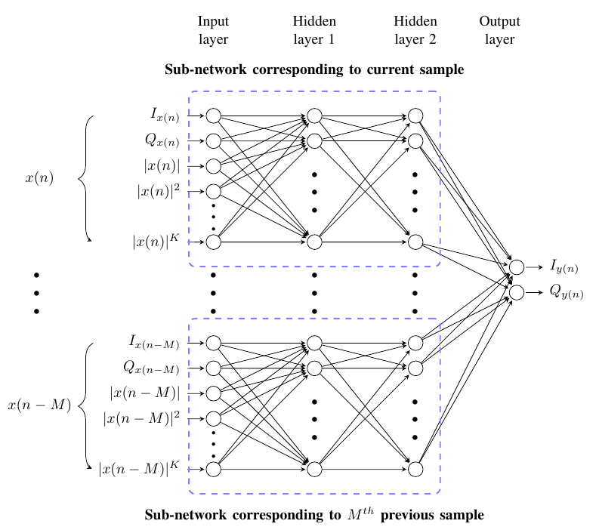
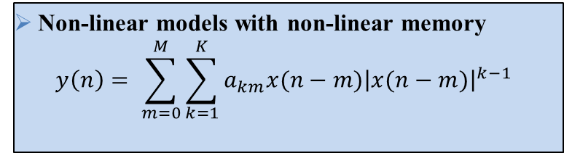
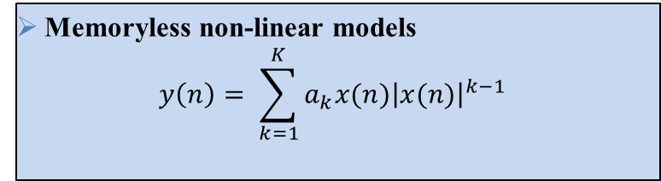
Literature Survey
Power Amplifier Models
Memoryless non-linear models
Non-linear models with linear memory
Non-linear models with non-linear memory
Memoryless non-linear models
$$y\left(n\right)= \sum_{k=1}^{K}{a_{k}x(n){\left|x(n)\right|}^{k−1}}$$
Non-linear models with non-linear memory
$$y\left(n\right)= \sum_{m=0}^{M}{\sum_{k=1}^{K}{a_{km}x(n−m){\left|x(n−m)\right|}^{k−1}}}$$

Slide 6
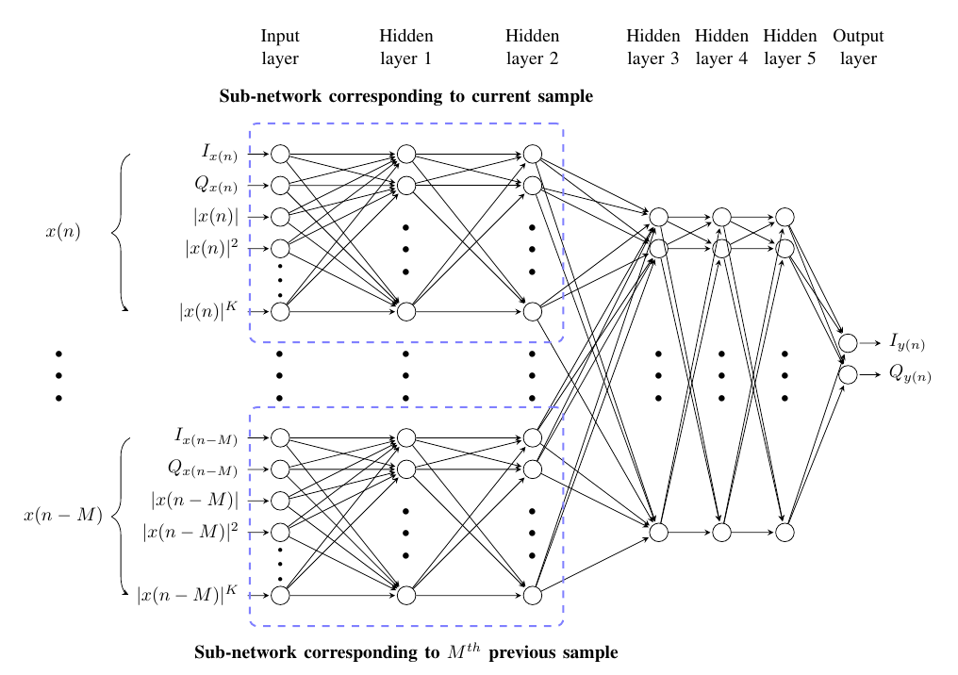
Proposed Solution – Network Architecture
Salient Features
Priority based on chronology of samples.
Low complex – exploiting conventional math model
Adaptive non-linear power terms for each sample
Network Hyper parameters
K = 2
M = 11
HL1 C = 9.
HL1 P = 5.
HL2 C = 5.
HL2 P = 2.
HL3 = 10.
HL 4 = 20.
HL 5 = 10.
OL = 2.

Slide 7
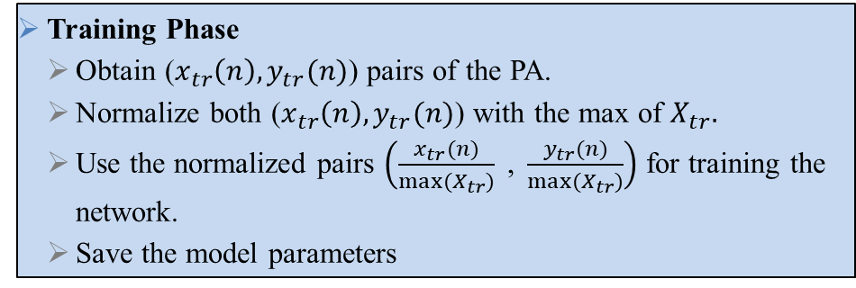
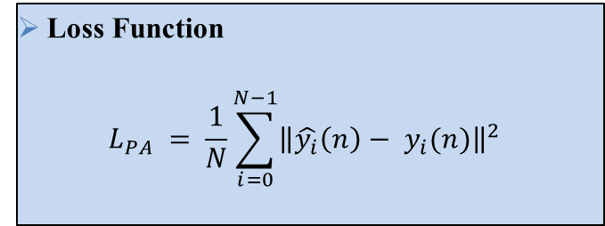
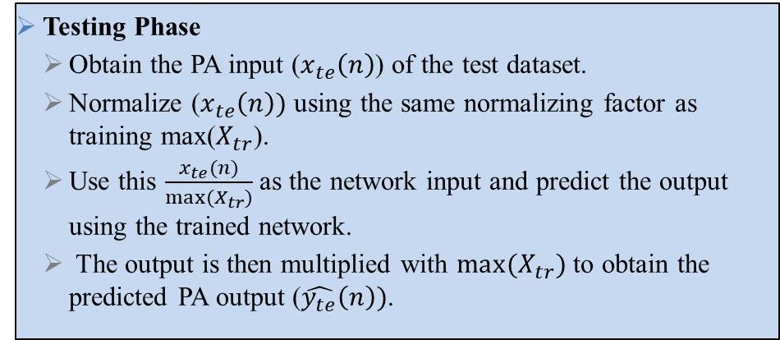
Proposed Solution – Training the Network
Training Phase
Obtain ($x_{tr}\left(n\right), y_{tr}(n)$) pairs of the PA.
Normalize both ($x_{tr}\left(n\right), y_{tr}(n)$) with the max of $X_{tr}.$
Use the normalized pairs $\left(\frac{x_{tr}(n)}{max⁡(X_{tr})}\text{ , }\frac{y_{tr}(n)}{max⁡(X_{tr})}\right)$ for training the network.
Save the model parameters
Loss Function
$$L_{PA} = \frac{1}{N}\sum_{i=0}^{N−1}{{\left\|\hat{y_{i}}\left(n\right)− y_{i}(n)\right\|}^{2}}$$
Testing Phase
Obtain the PA input ($x_{te}\left(n\right)$) of the test dataset.
Normalize ($x_{te}\left(n\right))$ using the same normalizing factor as training max($X_{tr}$).
Use this $\frac{x_{te}(n)}{max⁡(X_{tr})}$ as the network input and predict the output using the trained network.
The output is then multiplied with $max⁡(X_{tr})$ to obtain the predicted PA output ($\hat{y_{te}}\left(n\right))$.
Hyper-parameters | Value
Optimizer | Adam
Batch size | 200
Epochs | 3000
Loss function | MSE

Slide 8
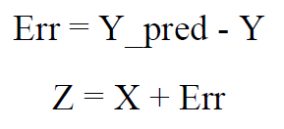
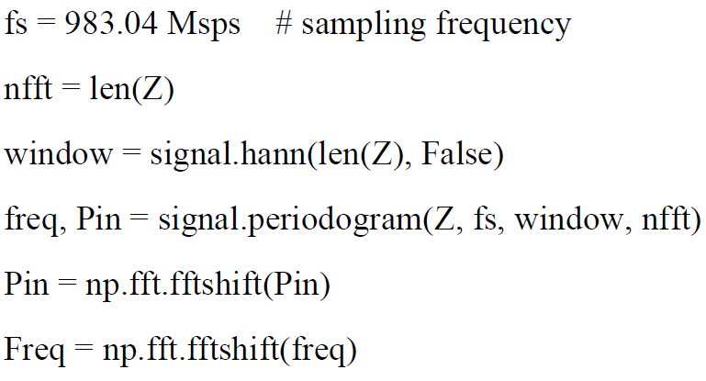
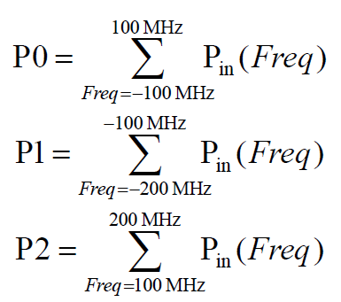
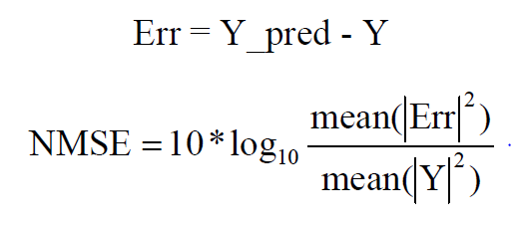
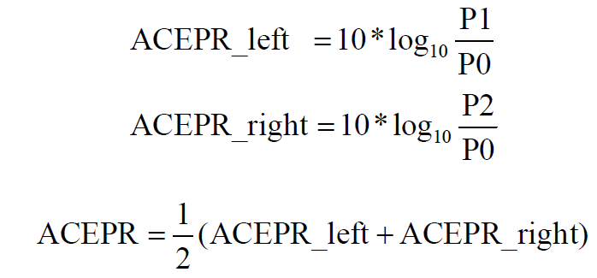
Results – Dataset and Metrics
ACEPR
Step 1
Step 2
Step 3
Step 4
Datasets
Training set – 183964.
Testing set – 40000.
1 – 20000 samples and 20000 – 40000 samples diff avg power
Testing set 2 – 40000.
1 – 20000 samples and 20000 – 40000 samples diff avg power
Testing set 3 – 65536.
Testing set 4 – 65536.
NMSE

Slide 9
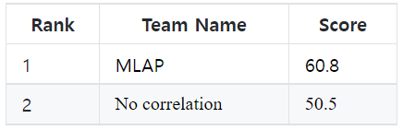
Results – Performance Metrics (NMSE and ACEPR) and Complexity Analysis
Dataset | NMSE (dB) | ACEPR (dB)
Train | -32.1 | -44.23
Test 1 – Complete | -33.56 | -44.27
Test 1 – Part 1 | -34.52 | -46.12
Test 1 – Part 2 | -28.97 | -43.52
Test 2 – Complete | -30 | -43.26
Test 2 – Part 1 | -28.43 | -42.71
Test 2 – Part 2 | -30.3 | -46.64
Test 3 | -33.71 | -46.3
Test 4 | -33.33 | -43.56
Layer | I/P Nodes | O/P Nodes | No. Layers | Real Mul
HL1 C | 4 | 9 | 1 | 36
HL1 P | 4 | 5 | 11 | 220
HL2 C | 9 | 5 | 1 | 45
HL2 P | 5 | 2 | 11 | 110
HL3 | 27 | 10 | 1 | 270
HL4 | 10 | 20 | 1 | 200
HL5 | 20 | 10 | 1 | 200
OL | 10 | 2 | 1 | 20
Total Real Multiplications |  |  |  | 1101
20 % better compared to next best

Slide 10
Results – Performance Metrics (NMSE and ACEPR)
Dataset | Old – LReLU for FCL |  | New – tanh for FCL |  | Improvement
 | NMSE (dB) | ACEPR (dB) | NMSE (dB) | ACEPR (dB) | NMSE (dB) | ACEPR (dB)
Train | -32.1 | -44.23 | -32.84 | -45.6 | 0.74 | 1.37
Test 1 – Complete | -33.56 | -44.27 | -34.97 | -45.68 | 1.41 | 1.41
Test 1 – Part 1 | -34.52 | -46.12 | -36.41 | -48.57 | 1.89 | 2.45
Test 1 – Part 2 | -28.97 | -43.52 | -29.35 | -45.77 | 0.38 | 2.25
Test 2 – Complete | -30 | -43.26 | -30.29 | -44.45 | 0.29 | 1.19
Test 2 – Part 1 | -28.43 | -42.71 | -28.39 | -44.36 | -0.04 | 1.65
Test 2 – Part 2 | -30.3 | -46.64 | -30.64 | -48.51 | 0.34 | 1.87
Test 3 | -33.71 | -46.3 | -34.68 | -48.46 | 0.97 | 2.16
Test 4 | -33.33 | -43.56 | -33.77 | -45.37 | 0.44 | 1.81
Avg | -31.66 | -44.51 | -32.37 | -46.31 | 0.71 | 1.8
A further improvement of 0.71 dB and 1.8 dB in NMSE and ACEPR, respectively.

Slide 11
Conclusion and Future Work
Conclusion
Proposed a neural network for PA modeling with chronology based priority for samples.
Improved performance with lower complexity.
Activation function when changed from LReLU to tanh in fully connected part (modeling memory part) resulted in improved performance.
Future Work
Using the PA model to compensate for non-linearity using DPDs.
Thereby, improving the signal quality and efficiency of the wireless communication system.

Slide 12
References
[1] Lei Ding, G. T. Zhou, D. R. Morgan, Z. Ma, J. S. Kenney, J. Kim, and C. R. Giardina, “A robust digital baseband predistorter constructed using memory polynomials,” IEEE Transactions on Communications, vol. 52, no. 1, pp. 159-165, Jan. 2004, doi: 10.1109/TCOMM.2003.822188.
[2] P. Saikrishna, A. Goyal, A. Kumar, A. K. R. Chavva, S. Kim and S. Lee, “Memory Polynomial-Inspired Neural Network to Compensate the Power Amplifier Non-linearities,” Accepted in IEEE Personal, Indoor and Mobile Radio Communications Conference, 2022.

